Slide 1
Patent Blue Dye Sophie Farooque Consultant in Allergy; Imperial College Healthcare NHS Trust

Slide 2
What We Already Know
Reported as a cause of anaphylaxis since the 1960s
Cardiovascular collapse is the commonest presentation
Allergic reactions can be delayed
Can interact with the pulse oximeter → falsely low saturations

Slide 3
Incidence of Anaphylaxis to Patent Blue Dye
Fourth most common cause of anaphylaxis in NAP6
Teicoplanin (16.4 per 100,000)
Patent Blue Dye (14.6 per 100,000 administrations)
Suxamethonium (11.1 per 100,000)

Slide 4
Demographics
Nine cases
None were fatal
Profound hypotension was common
Two thirds of patients required transfer to critical care
Surgery completed in seven patients but abandoned in two

Slide 5
Presenting Features
One third of patients had no skin signs
Urticaria was a presenting feature in only one patient
Hypotension was the commonest presenting feature
Hypotension was universal in all cases
Desaturation was the second commonest presenting feature

Slide 6
Latency
Reactions can be delayed
In five patients more than 10 minutes after injection
In two patients more than 60 minutes after injection

Slide 7
Diagnostically Challenging.
Delay in onset
Falsely low pulse oximeter readings
Skin signs are rarely a presenting feature
Dynamic tryptase change seen in 75% of patients

Slide 8
Resuscitation
Good (2)
Good and Poor (5)
Poor (2)
Adrenaline
CPR

Slide 9
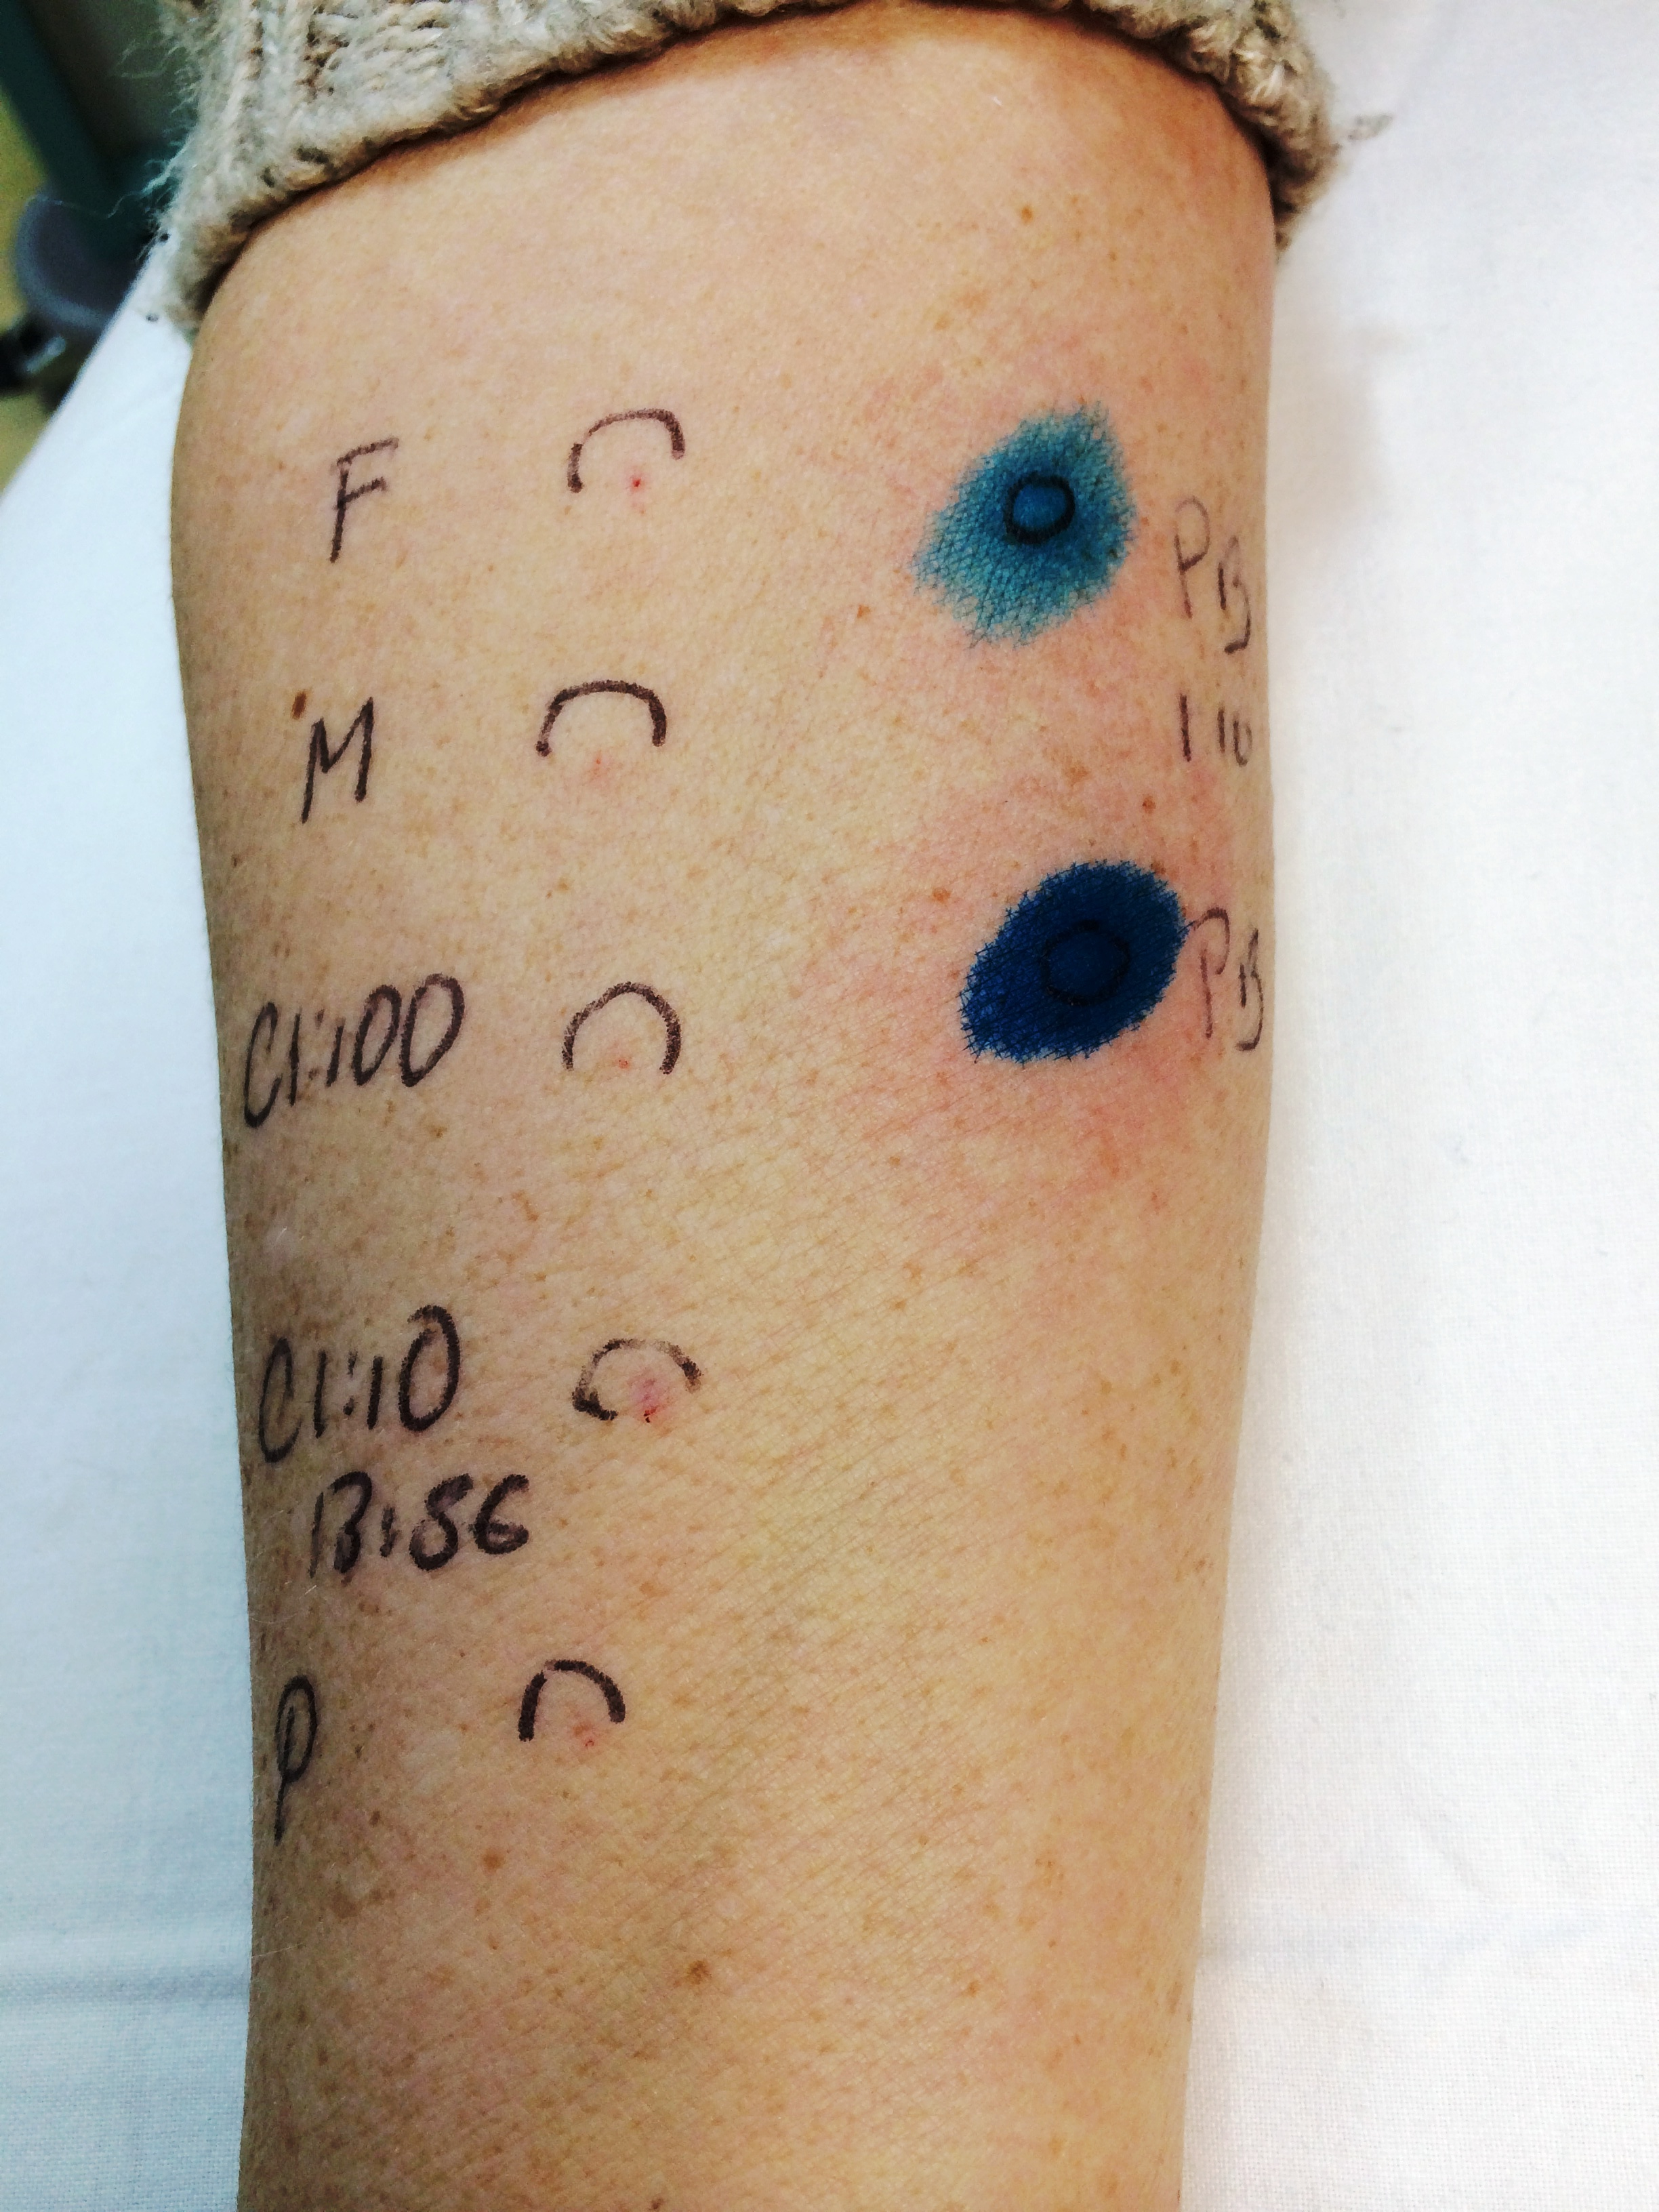
Allergy Clinic Assessment
Good (4)
Good and Poor (2)
Poor (1)
Not assessed (1)
Failure to investigate all culprit drugs

Slide 10
Referrals
Good correlation between anaesthetists’ suspicion and confirmation by the allergy clinics and the NAP6 review panel
Referrals mostly good
Methylene blue/Patent blue mixed up
Proceeded straight further surgery

Slide 11
What Do If Surgery is Abandoned?
Urgent allergy clinic assessment
Proceeding with surgery before allergy clinic investigation
Non-operative treatments.
Communicate!
Urgent discussion with the allergy clinic is likely to be useful

Slide 12
Key Recommendations
Consent
Do not assume patent blue dye is the culprit
Refer. Evaluate all drugs
If pulse oximeter saturations fall during anaphylaxis, assume it is real. Take a blood gas once the patient is stable

Slide 13
Thank you

